Slide 1

CSET 150
Network Design and Management
Evening Masters Edition
Dr. Mahboob Qaosar
Associate Professor, CSE, RU
Week # 1

Slide 2
Modular Network Design
What Is Modular Design?
A module is a component of a composite structure.
Modular network design involves creating modules that can then be put together to meet the requirements of the entire network.

Slide 3
Modular Network Design
Benefit: (Why Modular design???)
It is easier to understand and design smaller, simpler modules…
It is easier to troubleshoot …
The reuse of blocks saves design time and effort…
The reuse of blocks allows …growing … providing network scalability.
It is easier to change modules rather than the entire network, providing flexibility of design.

Slide 4
Modular Network Design
Two models that can be used for network design:
THE HIERARCHICAL MODEL.
THE CISCO ENTERPRISE COMPOSITE NETWORK MODEL.

Slide 5
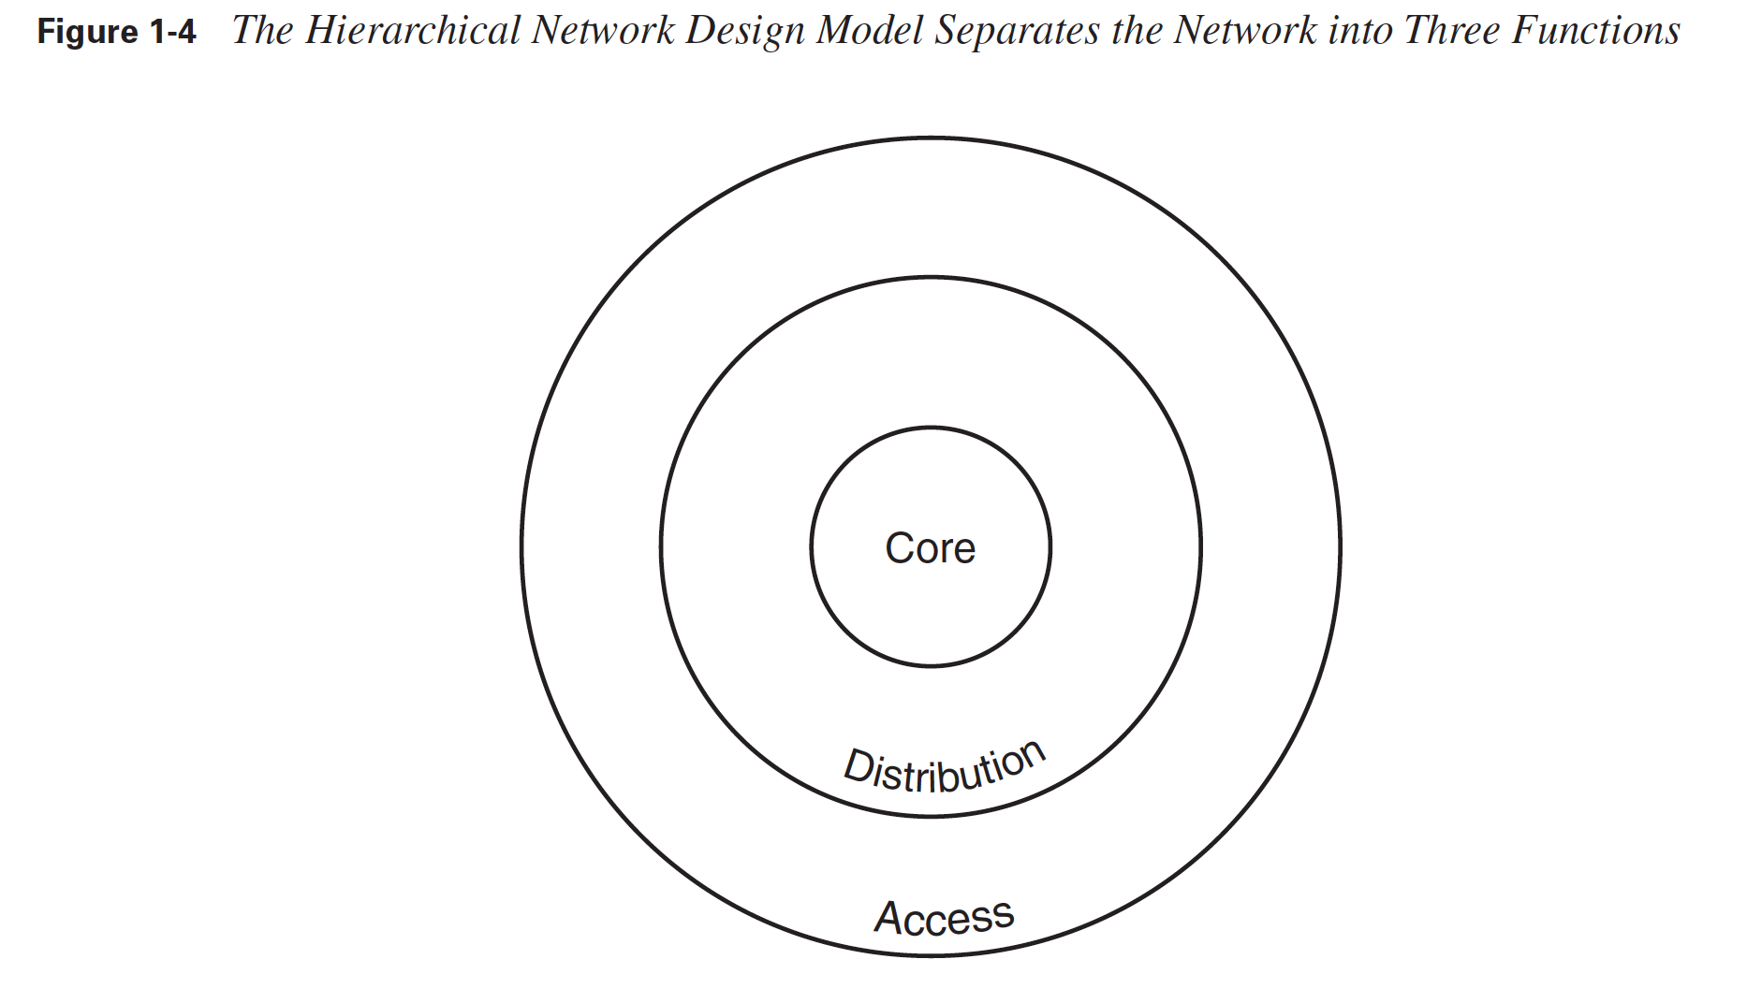
HIERARCHICAL NETWORK DESIGN
Hierarchical Network Design Model Separates the Network into Three Functions

Slide 6
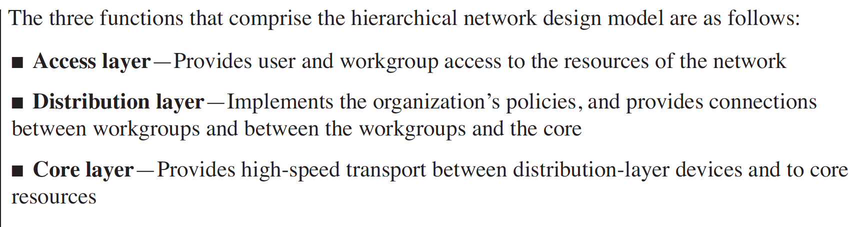
HIERARCHICAL NETWORK DESIGN

Slide 7
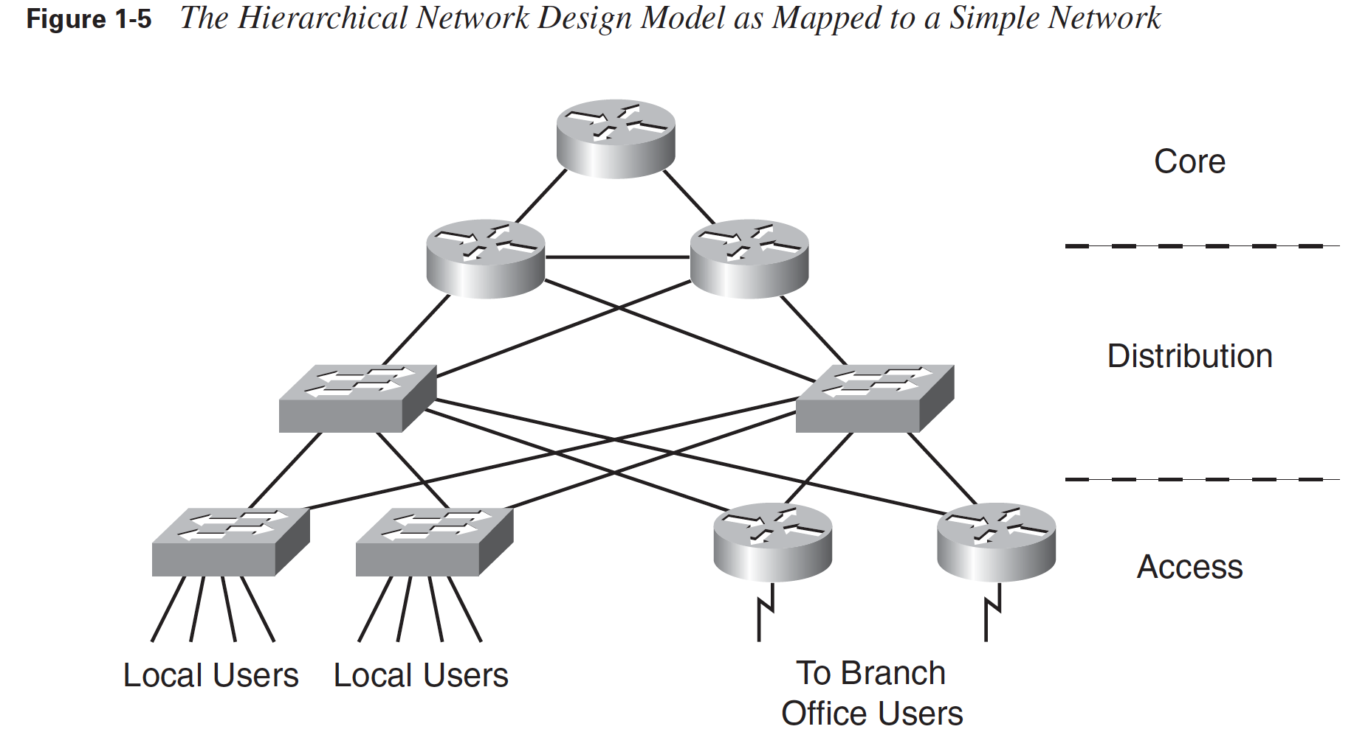
HIERARCHICAL NETWORK DESIGN

Slide 8
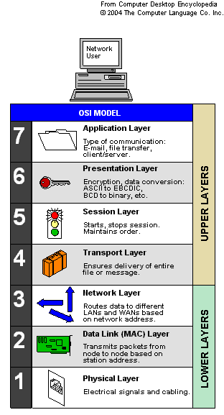
Access Layer
The access layer is where users access the network.
Users can be local or remote
Hubs operate at OSI Layer 1,
All devices connected to a hub are in the same collision domain.
Switches operate at Layer 2, and each port on a switch is its own collision domain

Slide 9
Access Layer
Using a LAN switch rather than a hub has a performance advantage:
A LAN switch forwards unicast traffic only out of the port through which the traffic's destination is considered reachable.
However, a hub forwards all traffic out of all its ports.
The access layer must also ensure that only users who are authorized to access the network are admitted.

Slide 11

Distribution Layer
The distribution layer interfaces
between the core and access layers, and
between access layer workgroups
Functions and characteristics include the following:
Implementing policies by filtering, and prioritizing and queuing traffic.
Routing between the access and core layers.
If different routing protocols are implemented at these other two layers, the distribution layer is responsible for redistributing (sharing) among the routing protocols, and filtering if necessary
Performing route summarization

Slide 12
Distribution Layer
Providing redundant connections, both to access devices and to core devices.
Aggregating multiple lower-speed access connections into higher-speed core connections and converting between different media types, if necessary.

Slide 13
Core Layer
The core layer provides a high-speed backbone.
Functions and attributes of the core layer include the following:
Providing high-speed, low- latency links and devices for quick transport of data across the backbone.
Providing a highly reliable and available backbone.
Adapting to network changes quickly by implementing a quick-converging routing protocol.
The routing protocol can also be configured to load-balance over redundant links so that the extra capacity can be used when no failures exist.
Filtering is not performed at this layer, because it would slow processing.
Filtering is done at the distribution layer.

Slide 14
Limitation of Hierarchical Model
The hierarchical model is useful for smaller networks, but it does not scale well to larger, more complex networks.
With only three layers, the model does not allow the modularity required to efficiently design networks with many devices and features.
The Enterprise Composite Network Model, provides additional modularity and functions

Slide 15
The Cisco Enterprise Composite Network Model
Cisco has developed a SAFE blueprint, the principle goal of which is to provide best practices information on designing and implementing secure networks.
The SAFE architecture uses a modular approach, providing the advantages previously discussed.
The Cisco Enterprise Composite Network Model is the name given to the architecture used by the SAFE blueprint.
This model supports larger networks than those designed with only the hierarchical model and clarifies the functional boundaries within the network.

Slide 16
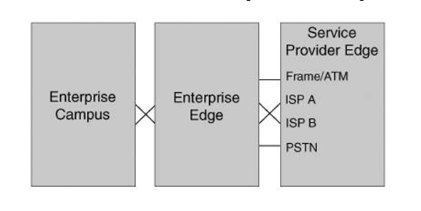
The Cisco Enterprise Composite Network Model
Functional Areas of the Enterprise Composite Network Model

Slide 17
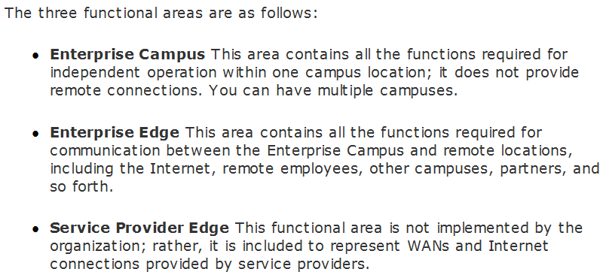
The Cisco Enterprise Composite Network Model

Slide 18
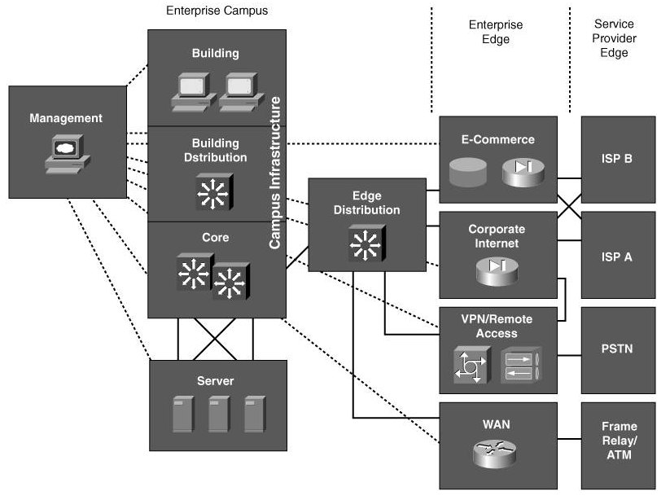
The Cisco Enterprise Composite Network Model

Slide 19
Enterprise Campus Functional Area
The modules within the ENTERPRISE CAMPUS FUNCTIONAL AREA are as follows:
Campus Infrastructure module
Management module
Server module
Edge Distribution module

Slide 20
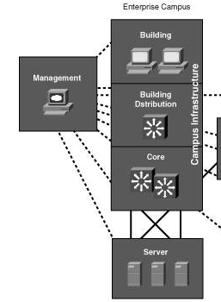
Campus Infrastructure module
The Campus Infrastructure module represents:
one or more buildings connected to a backbone.
This module is comprised of three sub-modules:
Building, Building Distribution, and Core.
These sub-modules map directly onto the hierarchical model's
access, distribution, and core layers.

Slide 21
Management Module
The Management module houses monitoring, logging, security, and other management features within an enterprise
Some of the management security :
An authentication, authorization, and accounting (AAA) server to provide security checks of users.
Authentication determines who the user is and whether he is allowed on the network.
Authorization determines what the user can do on the network.
Accounting records the time of day and time spent,
The AAA server can also record a user's location.

Slide 22
Management Module
Some of the management security :
Intrusion (interruption) detection system (IDS) and intrusion prevention system (IPS) management.
IDSs scan network traffic for malicious (Harmful) activity, while IPSs can protect the network if an attack is detected.
An IDS and IPS management server logs suspicious activities that are detected by IDS and IPS sensors deployed throughout the network.
System logging, for example, using a syslog server to log events and traps

Slide 23
Server Module
The centralized Server module contains internal campus servers.
These servers can include
e-mail, file, and print servers, or any other servers that are necessary for the network solutions
Layer 3 switches are typically used in this module to provide both
the high performance of Layer 2 switching and
the Layer 3 routing and filtering capabilities

Slide 24
Edge Distribution Module
The Edge Distribution module is the interface between the Enterprise Campus (through the Core sub-module) and the Enterprise Edge functional areas.
This module typically uses Layer 3 switching to provide high-performance routing, similar to the Server module.
Redundancy is again implemented in this module to ensure that the campus users always have access to the Enterprise Edge.

Slide 25
Enterprise Edge Functional Area
The Enterprise Edge functional area is the interface between the Enterprise Campus functional area (through the Edge Distribution module) and the Service Provider Edge functional area.
It is comprised of the following four modules:
E-commerce module
Corporate Internet module
VPN/Remote Access module
WAN module

Slide 26
E-commerce module
The E-commerce module includes the devices and services necessary for an organization to support e-commerce applications, such as online ordering.
The devices in this module usually include
web servers, application servers, and security devices such as firewalls and IDS appliances.

Slide 27
Corporate Internet Module
The Corporate Internet module provides Internet access for the users and passes VPN traffic from remote users to the VPN/Remote Access module.
Typical servers in this module include e-mail, File Transfer Protocol (FTP), and Domain Name System (DNS) servers.
Security systems, such as firewalls and IDSs/IPSs, are also present here to ensure that only legitimate Internet traffic is allowed into the enterprise.

Slide 28
VPN/Remote Access module
The VPN/Remote Access module terminates VPN traffic and dial-in connections from external users.
Typical devices in this module include dial-in access and VPN concentrators to terminate the remote user connections, and firewalls and IDS appliances to provide security.

Slide 29
WAN module
The WAN module provides connectivity between remote sites and the main site over various WAN technologies.
This module does not include the WAN connections; rather, it provides the interfaces to the WANs.
The WAN connections themselves are supplied by the service providers, which are represented in the Service Provider Edge modules.
Example WAN interfaces provided by this module are Frame Relay, Asynchronous Transfer Mode (ATM), cable, and leased lines.

Slide 30
Service Provider Edge Functional Area
The three modules within the Service Provider Edge functional area are as follows:
Internet Service Provider (ISP) module
Public Switched Telephone Network (PSTN) module
Frame Relay/ATM module

